Slide 1
ACADEMIC PROJECT REVIEW · REVIEW 4
Railway
Reservation System
Working prototype, evidence, and next test
[Project team] · [Institution] · [Review date]
Notes:
Introduce the project as a working prototype review. Name the team and institution, then state that the presentation will connect the passenger journey to the system evidence and the next test.

Slide 2
THE PASSENGER PROBLEM
One booking journey, many points of failure
INTENDED USERS
[Insert project context]
State the specific passenger group and the issue this prototype addresses.
A passenger needs to find a train, confirm a seat, and complete a booking without losing confidence along the way.
Keep this context project-specific. Do not imply a broader deployment than the prototype supports.
Review 4 goal: demonstrate the working prototype and what its results show.
02
Notes:
Frame the problem through the passenger's task. Then replace the bracketed context with the intended users and the precise issue addressed by the prototype.

Slide 3
BOOKING WORKFLOW
A reservation should move clearly from search to confirmation
IRCTC’s published e-ticket steps provide an operational reference for the journey shown here, not a claim about this project.
01
02
03
04
Search
Compare
Confirm
Complete
Route and travel date
Trains, classes, availability
Passenger details and fare
Payment and booking status
03
Notes:
Walk left to right. Emphasize that every stage has a clear handoff: the passenger knows what changed, what is required, and whether the reservation is complete.

Slide 4
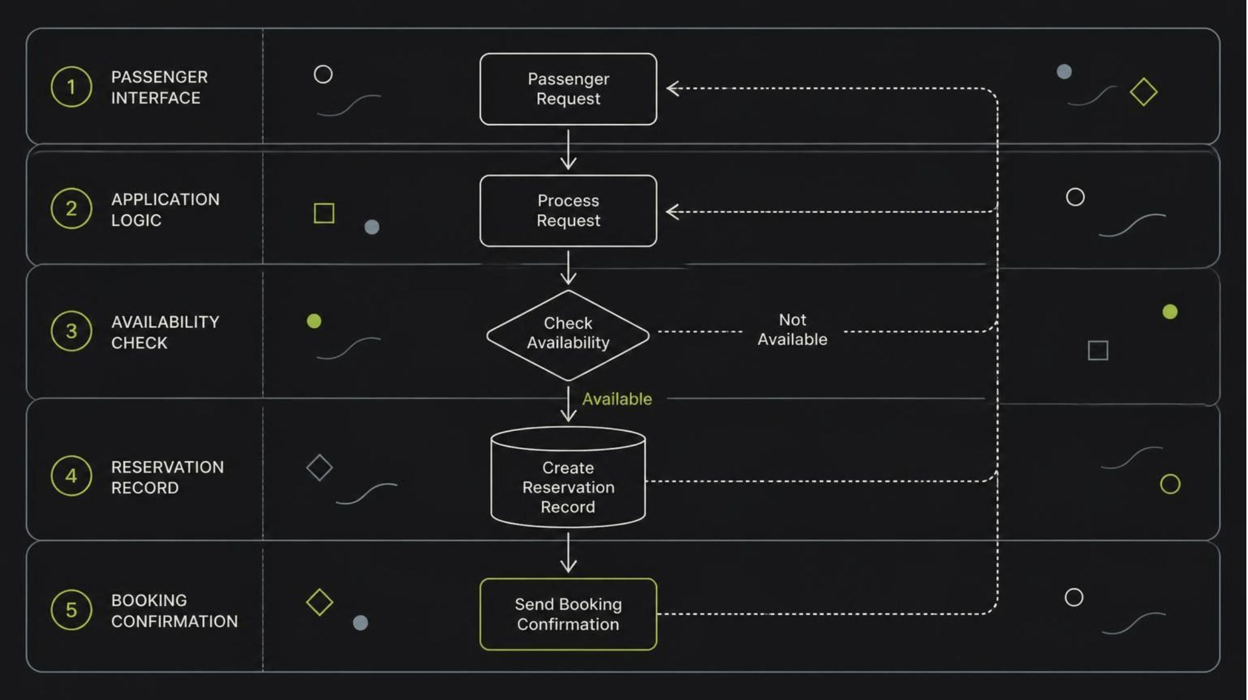
SYSTEM PROOF
The prototype connects passenger actions to reservation data
One request should remain traceable from the interface to the confirmation returned to the passenger.
IMPLEMENTED MODULES ONLY
Replace the stack field with the technologies used. Mark planned modules as future work.
[Insert stack]
04
Notes:
Trace one request through the architecture. Name the actual technology stack aloud where the placeholder appears, and distinguish implemented modules from future work.

Slide 5
TEST EVIDENCE
Test evidence shows what works—and what still needs work
CHECK | RESULT | OBSERVATION
End-to-end booking | [PASS / FAIL] | [Observed error or timing]
Test cases run | [Passed / total] | [Expected output comparison]
Outstanding issue | [OPEN] | [What still needs work]
Replace every bracketed field with supplied test data. Do not claim unprovided metrics.
05
Notes:
Demonstrate one booking from start to finish, then replace the evidence fields with the measured test data. Explain how each result was checked against the expected output.

Slide 6
IMPLEMENTED
PROPOSED
INNOVATION & SUSTAINABILITY
[Specific innovation]
[Sustainability idea]
Innovation and sustainability should solve a real passenger pain
[Concrete benefit: clearer availability or fewer avoidable booking steps]
A proposal for future validation, not a current capability.
Start with the feature that is genuinely implemented. Its value is the passenger problem it removes, not the novelty of the technology.
Additional sustainability ideas remain proposed until the prototype demonstrates them.
06
Notes:
Lead with the implemented feature and connect it to a specific passenger pain. Then label sustainability ideas clearly as proposed unless the demo proves them.

Slide 7
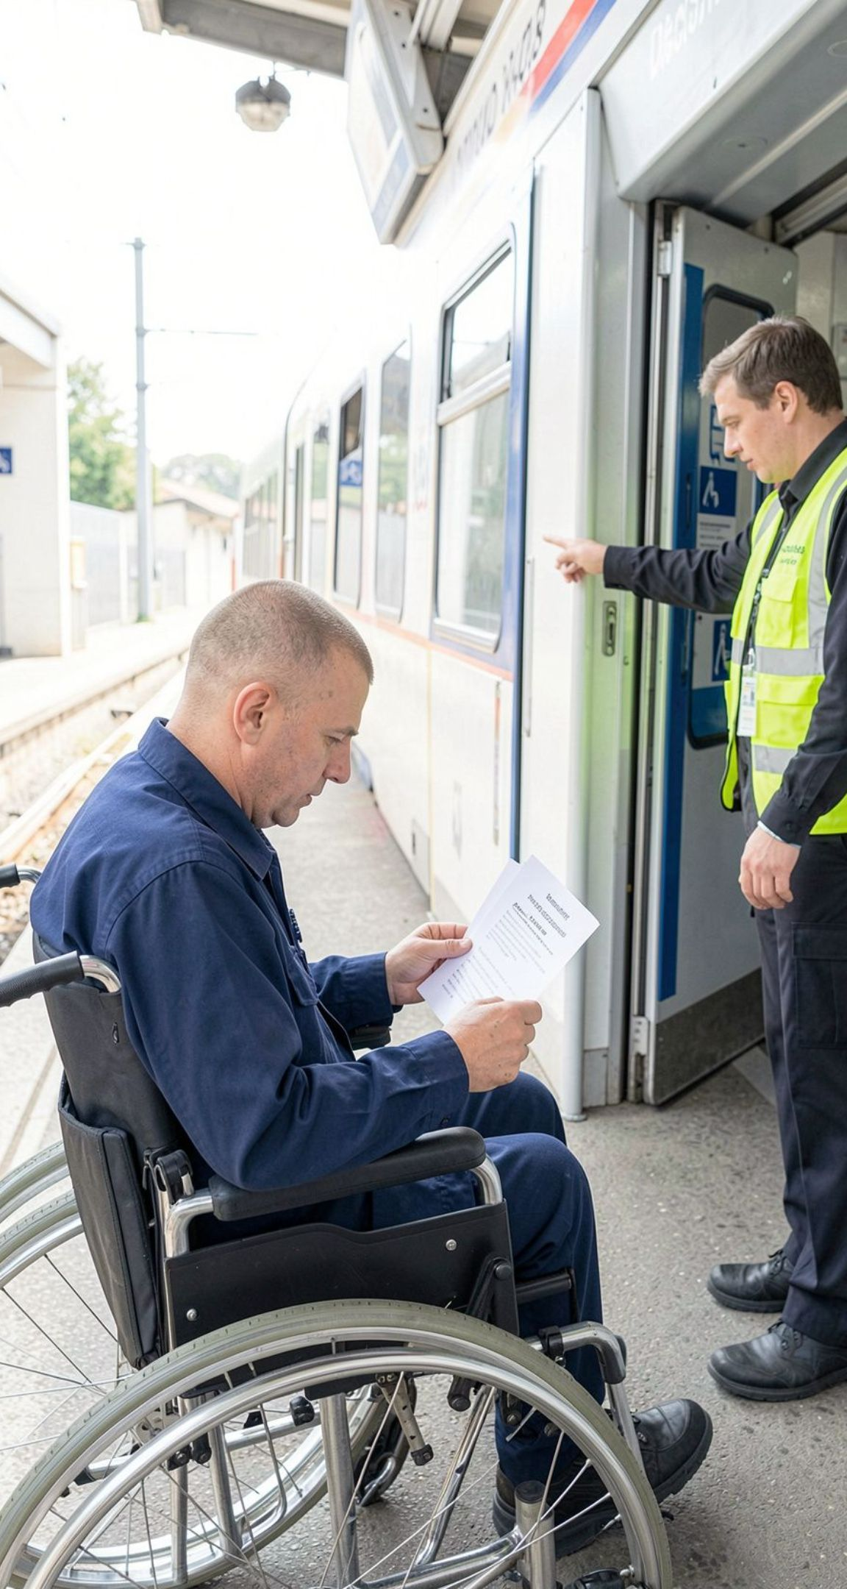
PASSENGER IMPACT
Reliable booking can make rail travel easier to access
For [specific user or community], clearer availability and fewer uncertain handoffs can reduce friction before travel begins.
Supports clarity
[Evidence or demo showing what the passenger can understand earlier]
Supports accessibility
[Evidence or demo showing who can use the flow and how]
Current boundary
The prototype can support [current capability], but cannot yet support [limitation].
07
Notes:
Make the intended passenger benefit concrete. Use the image to anchor the use case, then state the evidence and the current boundary precisely.

Slide 8
CLOSING TAKEAWAY
A clearer booking flow is the result to carry forward.
The prototype demonstrates [capability]; the strongest result is [test result]; the next test should validate [improvement].
RESULT
EVIDENCE
NEXT TEST
[Demonstrated capability]
[Strongest supplied result]
[Main limitation to validate]
Questions
Notes:
Recap only what the prototype demonstrates and what the supplied evidence supports. Name the main limitation, the next test, and invite questions.

